Slide 1
Vector Spaces
Orthogonal Vectors & Linear Independence

Slide 2
Outline
Orthogonality
Linear independence
Linear independence in Linear Regression

Slide 3
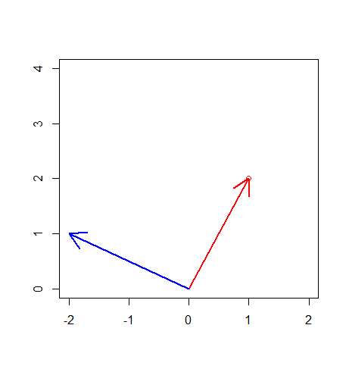
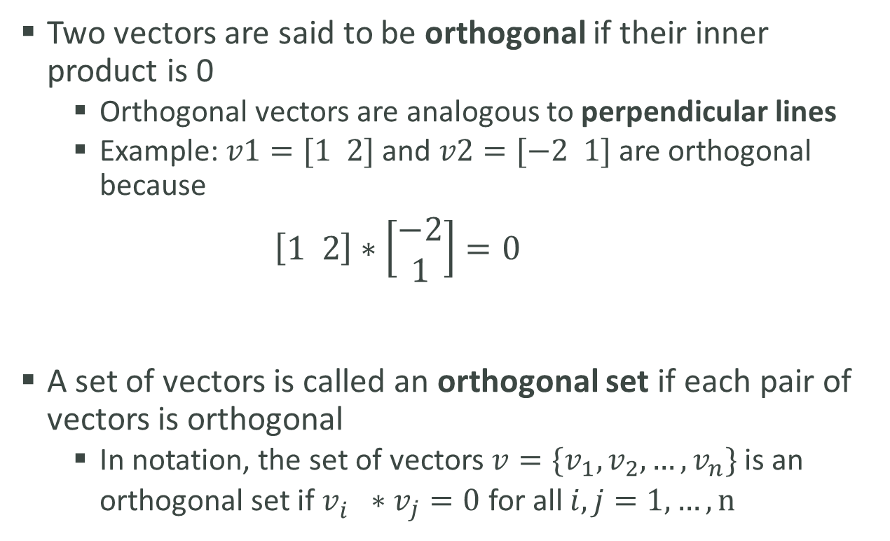
Orthogonality
Two vectors are said to be orthogonal if their inner product is 0
Orthogonal vectors are analogous to perpendicular lines
Example: $v1=[1 2]$ and $v2=[−2 1]$ are orthogonal because
$$\left[1 2\right]∗\left[\begin{matrix}−2 \\ 1\end{matrix}\right]=0$$
A set of vectors is called an orthogonal set if each pair of vectors is orthogonal
In notation, the set of vectors $v=\{v_{1}, v_{2}, …, v_{n}\}$ is an orthogonal set if $v_{i}^{}∗v_{j}=0$ for all $i,j=1,…, n$

Slide 4
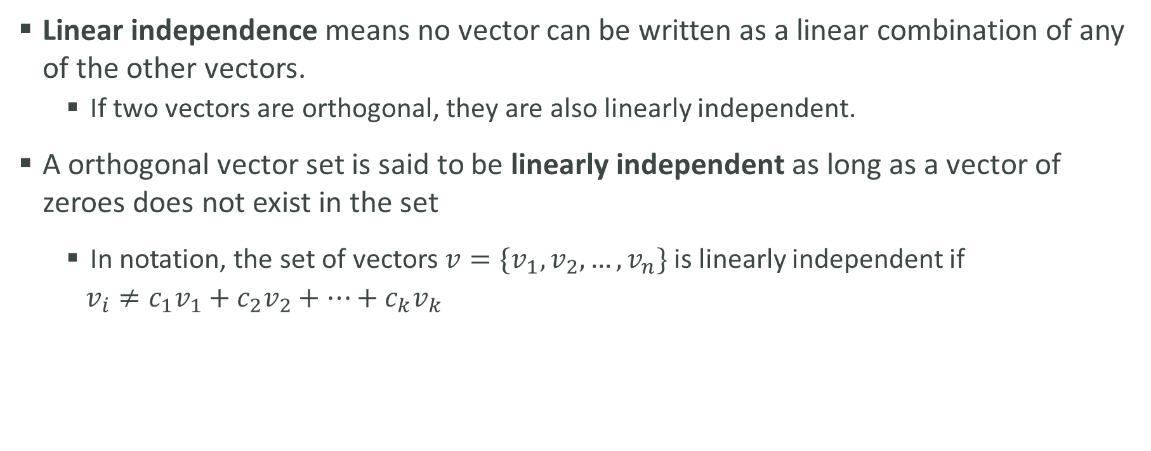
Linear Independence
Linear independence means no vector can be written as a linear combination of any of the other vectors.
If two vectors are orthogonal, they are also linearly independent.
A orthogonal vector set is said to be linearly independent as long as a vector of zeroes does not exist in the set
In notation, the set of vectors $v=\{v_{1}, v_{2}, …, v_{n}\}$ is linearly independent if
$v_{i}≠c_{1}v_{1}+c_{2}v_{2}+…+c_{k}v_{k}$

Slide 5


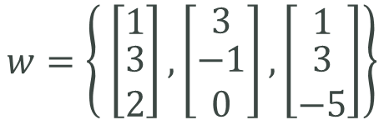
Linear Independence
Which of these vector sets is linearly independent?
Answer: $w$ is linearly independent
$$[\begin{matrix}1 & 3 & 2]\end{matrix}∗\left[\begin{matrix}3 \\ \begin{aligned}−1 \\ 0\end{aligned}\end{matrix}\right]=0, [\begin{matrix}1 & 3 & 2]\end{matrix}∗\left[\begin{matrix}1 \\ \begin{aligned}3 \\ −5\end{aligned}\end{matrix}\right]=0, [\begin{matrix}3 & −1 & 0]\end{matrix}∗\left[\begin{matrix}1 \\ \begin{aligned}3 \\ −5\end{aligned}\end{matrix}\right]=0$$
In $v$, $v2=v1+2∗v3$
$$v=\left\{ \left[\begin{matrix}0 \\ 1\end{matrix}\right], \left[\begin{matrix}−2 \\ 5\end{matrix}\right], \left[\begin{matrix}−1 \\ 2\end{matrix}\right]\right\}$$
$$w=\left\{ \left[\begin{matrix}1 \\ \begin{aligned}3 \\ 2\end{aligned}\end{matrix}\right], \left[\begin{matrix}3 \\ \begin{aligned}−1 \\ 0\end{aligned}\end{matrix}\right], \left[\begin{matrix}1 \\ \begin{aligned}3 \\ −5\end{aligned}\end{matrix}\right]\right\}$$

Slide 6
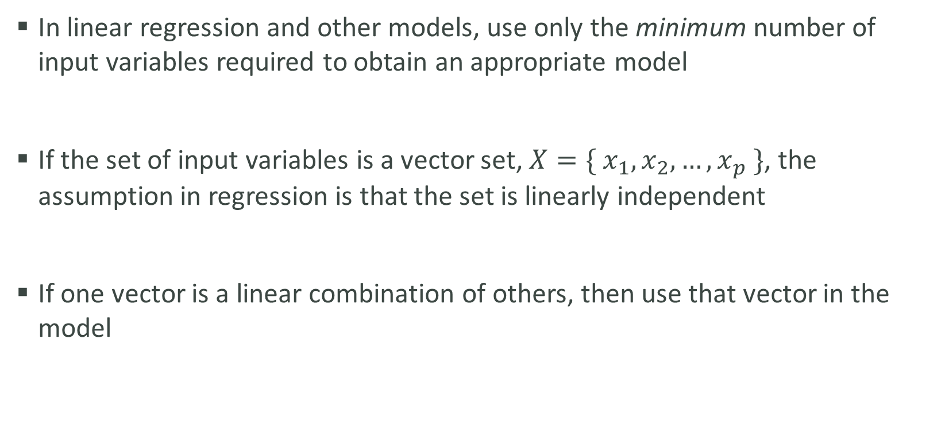
Linear Independence in Linear Regression
In linear regression and other models, use only the minimum number of input variables required to obtain an appropriate model
If the set of input variables is a vector set, $X=\{ x_{1}, x_{2}, …, x_{p} \}$, the assumption in regression is that the set is linearly independent
If one vector is a linear combination of others, then use that vector in the model

